Slide 1
Odoo Upgrade - Progress Reporting
July [26 to 30]

Slide 2

Overview

Slide 3
Overview
Project Documents and References:
Project Plan link:
https://docs.google.com/spreadsheets/d/18ZDAdHBzsEPdpr6rOwJDw2ViElgeVGW-ovWh-N8FheQ/edit?usp=sharing
Functional Test cases document:
https://docs.google.com/spreadsheets/d/12t1AjhoWo4CEOnC9snuApc7Y9-KMogo06I3qzkV-VHQ/edit?usp=sharing
UAT and Complete QA planning:
https://docs.google.com/spreadsheets/d/1zogqMJEMYcj1Ipb8xfOZKy1jcYYzcgeYiMnl-DUolIM/edit?usp=sharing
General action Items tracking sheet: https://docs.google.com/spreadsheets/d/1CQK9vK6pHrssCAB1glM9QhZQiUsD6ni9HpDKusIilDs/edit?usp=sharing

Slide 4
Progress Report -July [26 - 30]

Slide 5
Progress Report Summary - July [26 to 30]
Week Highlights:
Modules Migration [By Verts Team]
Saarus:
Feature-wise Demo is in Progress. Once done we can consider the milestone as completed.
Accounting feature demo of migrated version is pending which is lined up for next week.
Data migration initial basic showcase to Akshay is done, detailed migrated database review is planned.
KNK:
Completed the Migration of of KNK Finance Modules and the dependent modules.
Internal testing is going on from VERTS team as per Atulya’s updates.
Feature demonstration same on the line like Saarus, will kick start next week for finance modules of KNK.
Next Week Plan and Highlights: [August 02-06]
Modules Migration [By Verts Team]
Saarus:
Complete the demo of Saarus finance features of migrated modules.
Data migration detailed review sessions to start Tuesday onward.
UAT server to be setup for Saarus instance where KOKO team to start test run.
KNK:
Start the demo for the KNK Finance feature.
Review of dependent modules other than finance is expected to start later next week.

Slide 6
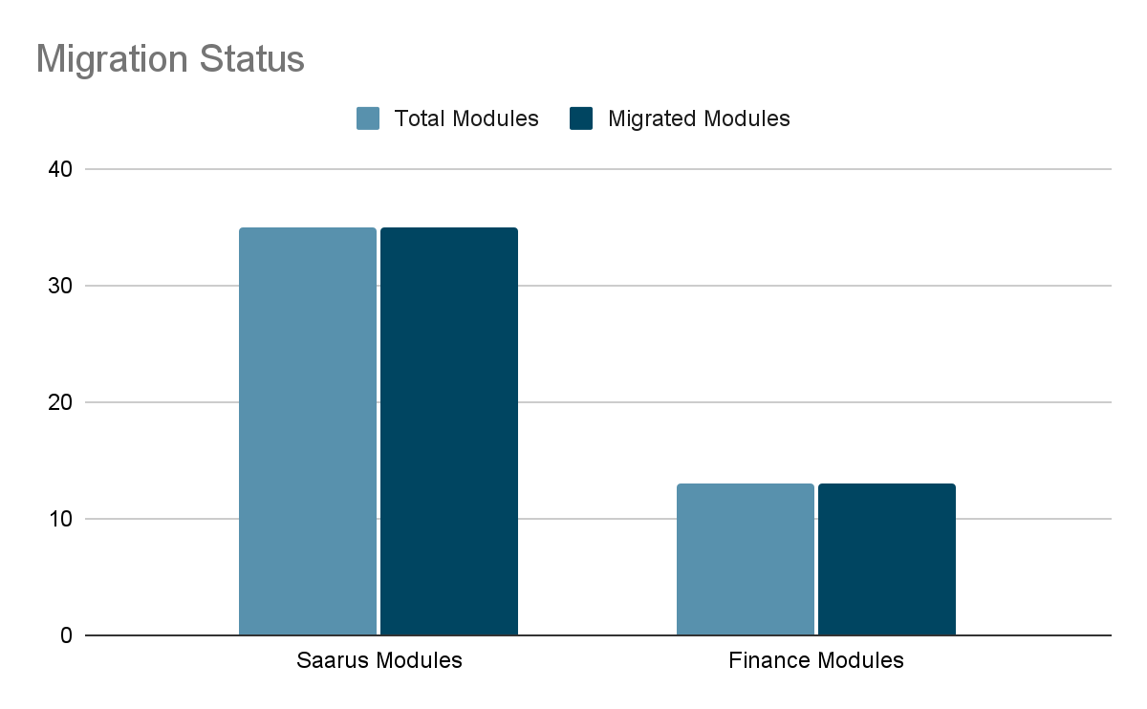
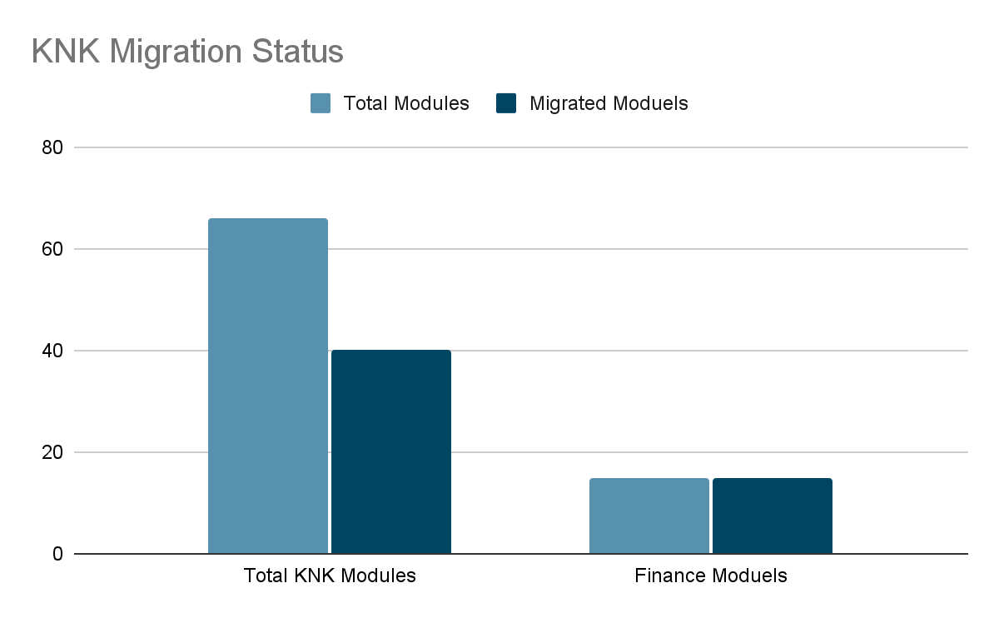
Progress Analysis
Saarus Code Migration Status
KNK Code Migration Status

Slide 7
Risks and Issue
Considerable delay in the milestone in the project deadline.
Parallel project execution is not happening as Verts promised at the time of agreement. As we have not seen any logical progress on KNK side in couple of weeks.

Slide 8
Madhav Agarwal / Siddique Momin
m.agarwal@kokonetworks.com , s.momin@kokonetworks.com

